Slide 1


Will Begin In:
5:00
Breaking Through Adoption Barriers Of Evidence-Based SUD Treatment Models
How KCS Health Center Expanded From Basic Access To A Fully Integrated SUD 2.0 Model

Slide 2
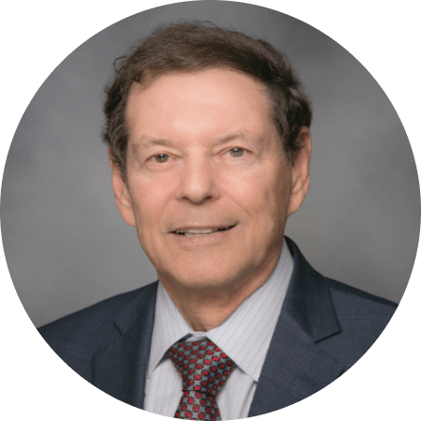
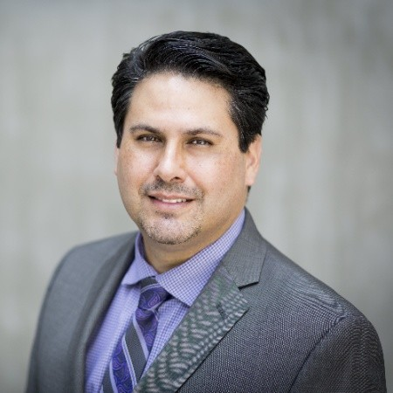

Today’s Speakers
Will Begin In:
5:00
Stuart Buttlaire, PhD
Vice President, Clinical Excellence
& Leadership at OPEN MINDS
Mario San Bartolomé
M.D., M.B.A., M.R.O., FASAM
Medical Director, Substance Use Disorders, KCS Health Center
2

Slide 3

What You’ll Learn
Will Begin In:
5:00
Why “good enough” SUD care models still leaves critical gaps
How KCS Health Center evolved from basic access into a fully integrated “SUD 2.0” model
Operational strategies for reducing workforce resistance and increasing adoption of evidence-based care
Leadership approaches that sustain long-term organizational transformation
3

Slide 4
What You’ll Learn
Why “good enough” SUD care models still leaves critical gaps
How KCS Health Center evolved from basic access into a fully integrated “SUD 2.0” model
Operational strategies for reducing workforce resistance and increasing adoption of evidence-based care
Leadership approaches that sustain long-term organizational transformation
4

Slide 5
Breaking Through Adoption Barriers Of Evidence-Based SUD Treatment Models
How KCS Health Center Expanded From Basic Access To A Fully Integrated SUD 2.0 Model

Slide 6
Why This Matters
Co-occurring psychiatric conditions, trauma, homelessness, and medical complexity are the norm rather than the exception
Provider organizations are under pressure— workforce shortages, burnout, turnover, reimbursement challenges, etc
Despite growing evidence supporting MOUD, long-acting injectable medications, rapid-access treatment models, harm reduction approaches, and integrated care, organizations still struggle with implementation
Transformation requires leaders who can communicate transparently, build trust, create psychological safety, support workforce readiness, and maintain accountability
6

Slide 7
Today’s Speakers
Stuart Buttlaire, PhD
Vice President, Clinical Excellence
& Leadership at OPEN MINDS
Mario San Bartolomé
M.D., M.B.A., M.R.O., FASAM
Medical Director, Substance Use Disorders, KCS Health Center
7

Slide 8

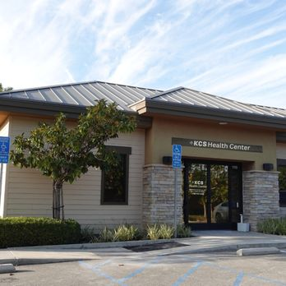
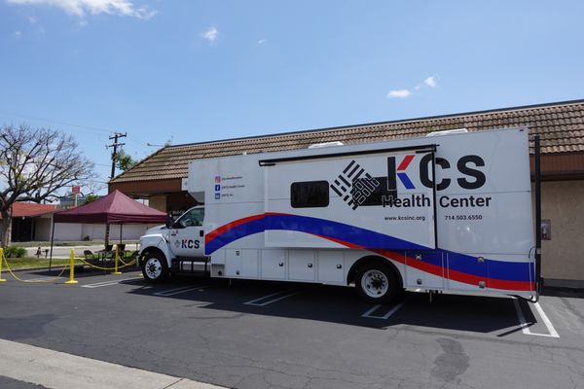
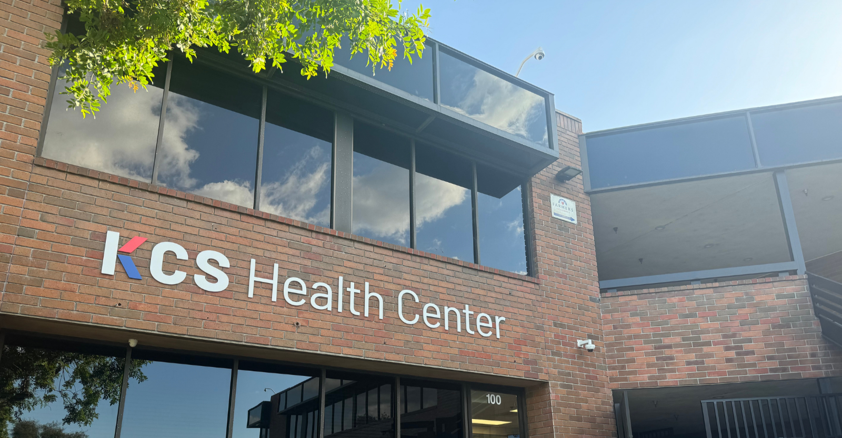
KCS Health Center
FQHC serving complex, high-risk populations across Orange County
Founded in Los Angeles in 1977, relocated to Orange County in 1992
7 full-service Health Clinics, 3 counseling centers, 3 community support centers
8

Slide 9
KCS Health Center
Expanded from Korean Community Services into broader community-based behavioral health and SUD care
Focus on rapid-access treatment, integrated behavioral health, and wraparound support
Serves patients with significant SDOH, psychiatric, medical, and justice-involved complexity
9

Slide 10
Why Traditional SUD Models Are No Longer Enough
Traditional models often:
Current realities:
fentanyl complexity
co-occurring conditions
justice re-entry
unstable housing
workforce shortages
fragmented care
focus only on medication access
lack wraparound support
struggle with retention
fail during transitions of care
create provider burnout
10

Slide 11
KCS Solved The First Challenge: Access
Initial Transformation Goals:
  Same-day/rapid access care
  MAT/MOUD expansion
  Behavioral health integration
  Workforce training
  ASAM competency
  Telehealth access
“We had already exceeded what a typical clinic could imagine doing. But we knew we could do better.”
Mario San Bartolomé
11

Slide 12
Why KCS Launched “SUD 2.0”
The Question Became:
“What are we still missing?”
What SUD 2.0
Actually Added
Remaining Gaps:
New Capabilities:
Psychoeducation groups
relapse prevention support
family engagement
care coordination
justice re-entry
perinatal support
adolescent pathways
SDOH stabilization
reimbursement gaps
long-term engagement
Peer support
Contingency management
Employment assistance
Lead care managers (LCMs)
Family telehealth integration
Structured care tracks
Re-entry support
Higher-touch engagement models
12

Slide 13
“SUD care became a system,
not a service line.”
13

Slide 14
The Wraparound Care Model
Core Philosophy
Components
“Every patient receives a wraparound approach — but intensity varies based on need.”
Medical + behavioral integration
Important Concept
Low barrier to entry + precision support allocation
Dynamic reassessment
Family involvement
Telehealth support
High-touch stabilization
Weekly interdisciplinary review
14

Slide 15
Low Barrier Access, High Precision Care
Initial Entry:
Then:
Immediate access
Minimal barriers
Telehealth intake
Rapid assessment
Risk stratification
Interdisciplinary review
High-priority identification
Assigned lead care manager
Escalated touchpoints
15

Slide 16
What Actually Drove Adoption
Where Resistance Showed Up
Leadership Strategies
Mission
Staff discomfort with treating SUD populations
Competence
Lack of confidence/training
Risk
Fear of:
liability
noncompliance
diversion
burnout
legal exposure
Strong clinical champion
Mid-level peer champion
Ongoing reinforcement
Workforce protection
Psychological safety
Modeling behavior
Repetition
Accountability
Incentivization
16

Slide 17


Operational Lessons Learned:
What Made The Biggest Difference
Flattening ownership across teams
Cross-training staff
Interdisciplinary collaboration
Protecting workforce capacity
Flexible workflows
Leadership alignment
Reimbursement creativity
Incremental implementation
17

Slide 18
Measurement Strategy
Operational Metrics
  Patients served
  MAT/MOUD utilization
  Screening completion
  BH referral follow-through
  Hep C treatment completion
  Engagement duration
Future Focus
  Retention measurement
  Disengagement analysis
  Longitudinal engagement tracking
18

Slide 19
Strategic Discussion With
Stuart Buttlaire
19

Slide 20
Many organizations still struggle to move from “basic access” to fully integrated SUD care.
From your perspective, what operational capabilities become most important once access is no longer the primary barrier?
+
20

Slide 21
Workforce resistance remains one of the biggest barriers to implementing evidence-based SUD treatment.
What leadership behaviors most strongly influence long-term workforce adoption and engagement?
21

Slide 22
Many provider organizations worry about sustainability when expanding wraparound services.
How should leaders think about balancing financial realities with long-term patient outcomes and system impact?
22

Slide 23
Looking ahead, what operational or system-level changes will organizations need to make to remain effective in the evolving SUD treatment environment?
23

Slide 24

For health system leaders, behavioral health executives, and policymakers listening today—what are the most important steps they should consider if they want to move toward more integrated care fr co-occurring disorders?
Explore Upcoming Webinars & Resources At RECADEMY.org
24

