Slide 1


Will Begin In:
Whole Person Care For Consumers With Co-Occurring Intellectual & Developmental Disabilities (I/DD) And Substance Use Disorders (SUD)
How Monarch Developed A Specialized Treatment Model For A Historically Underserved Population

Slide 2
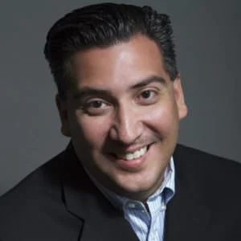
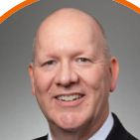

Today’s Speakers
Will Begin In:
Rick Gutierrez
Senior Associate,
OPEN MINDS
Todd Posey
M.Ed., LCMHCS, LCAS, CCS
Vice President of Clinical Best Practice,
Monarch
2

Slide 3

What You’ll Learn
Will Begin In:
Why “good enough” SUD care models still leaves critical gaps
How KCS Health Center evolved from basic access into a fully integrated “SUD 2.0” model
Operational strategies for reducing workforce resistance and increasing adoption of evidence-based care
Leadership approaches that sustain long-term organizational transformation
3

Slide 4
What You’ll Learn
Why “good enough” SUD care models still leaves critical gaps
How KCS Health Center evolved from basic access into a fully integrated “SUD 2.0” model
Operational strategies for reducing workforce resistance and increasing adoption of evidence-based care
Leadership approaches that sustain long-term organizational transformation
4

Slide 5
Whole Person Care For Consumers With Co-Occurring Intellectual & Developmental Disabilities (I/DD) And Substance Use Disorders (SUD)
How Monarch Developed A Specialized Treatment Model For A Historically Underserved Population

Slide 6
Why This Matters
Consumers with co-occurring intellectual and developmental disabilities (I/DD) and substance use disorders (SUD) are often excluded from traditional treatment models
Many provider organizations lack clinical frameworks, workforce training, and operational infrastructure to effectively serve this population
Treatment fragmentation frequently results in poor engagement, repeated crises, justice involvement, housing instability, and avoidable utilization
Few evidence-based models exist specifically designed for individuals with co-occurring I/DD and SUD needs
Provider organizations are increasingly being asked to address higher-acuity, more clinically complex populations with limited specialized workforce capacity
6

Slide 7
The Monarch Model
Eligible Consumers
The curriculum was developed for individuals with intellectual and developmental disabilities (I/DD) and co-occurring substance use disorders (SUD), as well as the families, caregivers, and support professionals involved in their recovery journey.
The model supports individuals across a range of cognitive abilities and was designed to address the unique challenges faced by people with I/DD, autism spectrum disorder, traumatic brain injury, and other cognitive impairments who may be underserved by traditional addiction treatment approaches.
Treatment Components
The curriculum includes:
14 structured recovery modules addressing core addiction and recovery concepts
Original animated educational videos designed specifically for the I/DD population
Facilitator discussion guides
Interactive learning activities
Psychoeducational resources
Take-home recovery materials
Adapted screening and assessment tools
Family and caregiver support resources
English and Spanish-language materials
7

Slide 8
“Understanding Addiction and
Developmental Disabilities”
Topics include addiction, medication safety, triggers, relationships, codependency, recovery, emotional regulation, coping skills, relaxation techniques, self-esteem, and wellness. The curriculum is designed for both individual and group delivery and can be adapted to meet varying support needs.
Length Of Treatment
The curriculum is intentionally flexible rather than time limited. Organizations may use individual modules as standalone interventions or deliver the complete 14-unit curriculum as part of a broader recovery program. The model encourages providers to move at the pace of the individual, repeating content and reinforcing concepts as needed to support learning and retention.
8

Slide 9
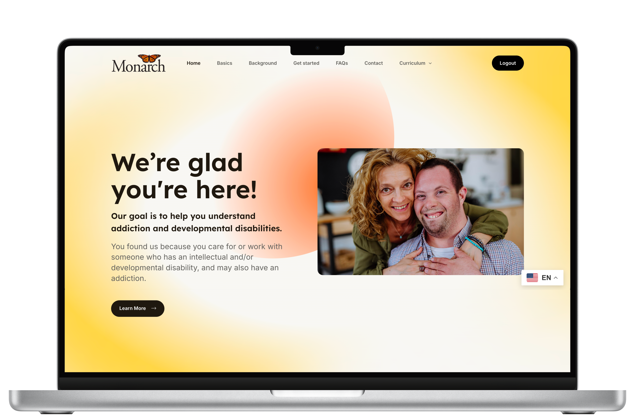
understanding.monarchnc.org
9

Slide 10
How This Model Is Different
Traditional SUD Treatment
Designed for the general population
Relies heavily on abstract concepts and verbal processing
Assumes standard cognitive functioning
Focuses primarily on the individual receiving treatment
Standard screening and assessment approaches
Limited accommodations for communication needs
Recovery education developed by clinicians
Few specialized resources available nationally
The Monarch Model
Designed specifically for individuals with I/DD and cognitive differences
Uses concrete language, visual learning, and simplified communication
Adapts content for varying cognitive abilities and learning styles
Incorporates caregivers, family members, and support systems
Includes tools adapted for the I/DD population
Emphasizes accessibility, repetition, reinforcement, and individualized pacing
Recovery education co-designed with individuals with lived experience and families
Open-access curriculum available at no cost to providers and organizations
10

Slide 11
Today’s Speakers
Todd Posey
M.Ed., LCMHCS, LCAS, CCS
Vice President of Clinical Best Practice,
Monarch
Rick Gutierrez, Ph.D.
Senior Associate,
OPEN MINDS
11

Slide 12

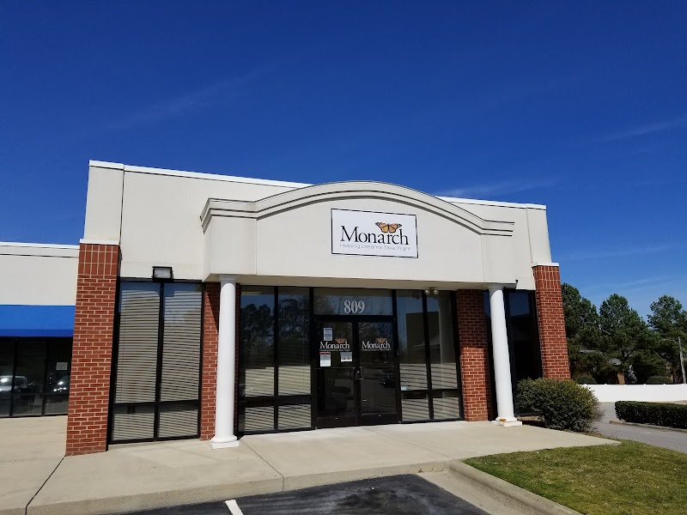
About Monarch
Nonprofit provider organization serving individuals with mental illness, substance use disorders (SUD), intellectual and developmental disabilities (I/DD), and traumatic brain injury (TBI)
Provides support to more than 27,000 individuals annually across North Carolina and Rhode Island
Team of nearly 1,600 staff members delivering behavioral health, outpatient, crisis, residential, and community-based services
12

Slide 13
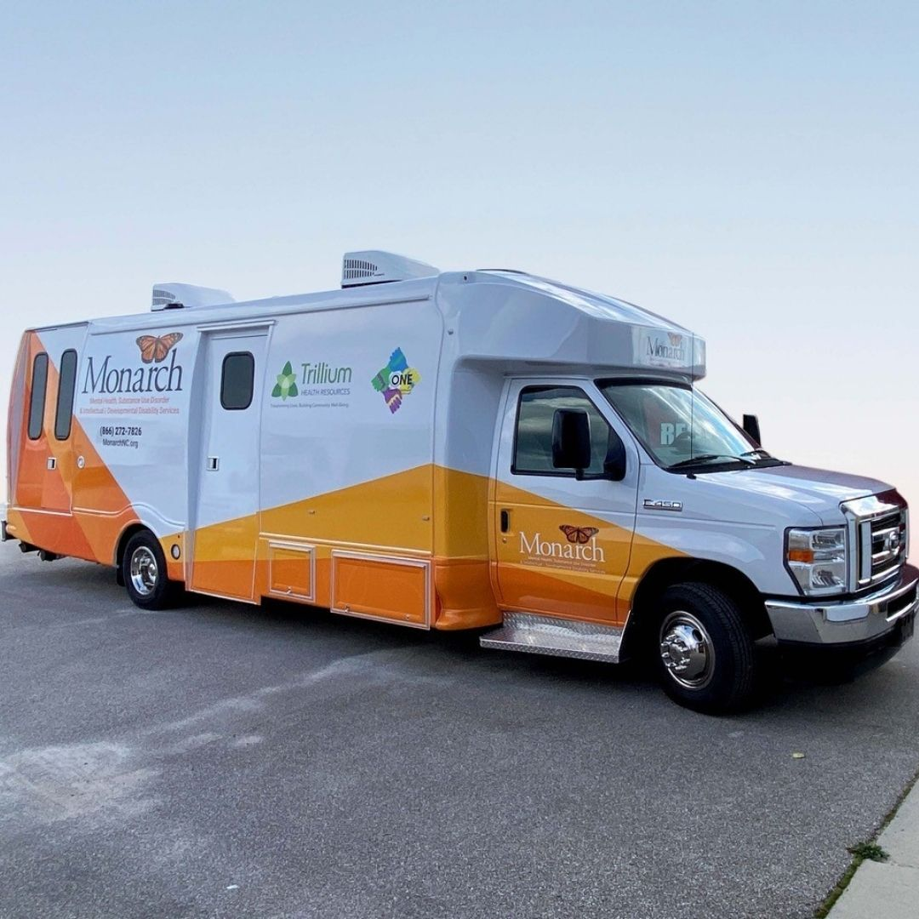
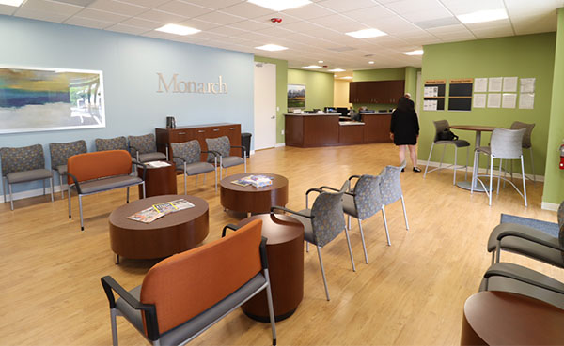
About Monarch
Nationally accredited by The Joint Commission
Mission-driven focus on promoting wellness, recovery, independence, and long-term community integration
Longstanding organizational history serving individuals with I/DD, dating back to its founding in 1958 by families advocating for services and inclusion
Strong emphasis on innovation, person-centered care, workforce development, and data-driven operational leadership
13

Slide 14
Consumers With Co-Occurring I/DD And SUD Were Falling Through Traditional Systems
Services for I/DD and SUD were frequently separated across different provider systems, leaving individuals with complex needs, including cognitive differences, communication challenges, or varying levels of adaptive functioning, without integrated treatment pathways or coordinated support.
As a result, consumers were often excluded from services due to behavioral complexity, difficulty engaging in traditional group models, or assumptions about their ability to participate effectively in treatment.
Monarch also identified significant workforce challenges, including limited clinician confidence, minimal training resources, and a lack of operational guidance for treating individuals with co-occurring I/DD and SUD. Long-term engagement and retention remained persistent challenges across traditional models of care.
14

Slide 15
“ If we don’t build this model,
who will? ”
15

Slide 16
The Background
When NC DHHS issued a grant announcement focused on co-occurring I/DD and SUD, Monarch began researching the landscape and reaching out to leaders across the field, including contacts at the Duke Addictions Program—research that revealed very few operational models existed designed specifically for this population.
The absence of established models reinforced the urgent need for innovation. Receiving the grant laid the groundwork for Monarch’s specialized approach.
From the beginning, the initiative was intended not only to improve care delivery internally, but also to help disseminate learning, tools, and operational strategies across North Carolina and beyond.
16

Slide 17
Building A Specialized
Treatment Framework
What Monarch Developed
The final model included a series of structured treatment units designed to support engagement, recovery education, and long-term skill development for individuals with co-occurring I/DD and SUD.
Each session included multiple components, including video-based learning modules, guided discussion tools, interactive recovery activities, and psychoeducational resources adapted for different learning needs.
Early work focused on adapting traditional SUD treatment concepts into a model that would be more accessible, practical, and clinically appropriate for individuals with I/DD through:
Simplifying engagement strategies
Adapting psychoeducational materials for varying cognitive abilities
Building more structured treatment supports
Increasing caregiver and family involvement
Improving workforce competency and clinical confidence
Creating materials that could be replicated consistently across programs and settings
17

Slide 18
Centering Lived Experience
Development of Monarch’s curriculum was shaped by those who understand this population best—because they are this population.
As consistent, active collaborators, the group met with Monarch’s team on a weekly basis over the course of several months.
Beyond feedback, the group ensured the materials reflected the real needs, strengths, and experiences of the people it was designed to serve.
The Workgroup
Approximately 15 individuals with lived experience with I/DD served as essential partners throughout the process.
18

Slide 19
“ We learned far more from them
than they did from us. ”
19

Slide 20
The Goal:
The Solution:
Accessible, practical, and clinically appropriate SUD treatment information for individuals with I/DD.
A free and interactive learning curriculum structured in approachable modules.
20

Slide 21
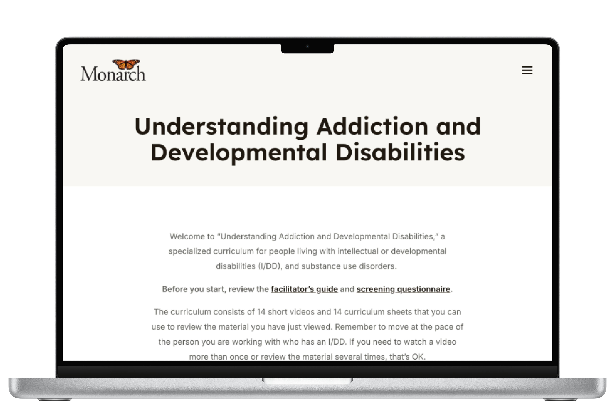
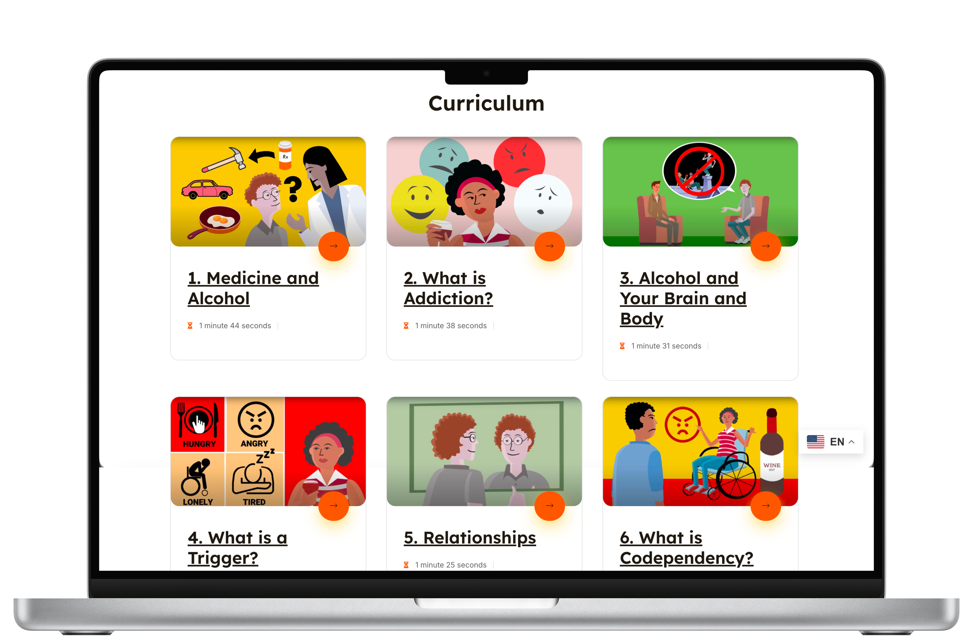
understanding.monarchnc.org
21

Slide 22
Building Something Providers Could Actually Use
What Made The Model Different
Traditional SUD treatment models often assume standardized cognitive processing, high levels of self-directed insight, and the ability to participate consistently in conventional psychoeducation and group therapy environments.
Materials designed to be practical, flexible, and accessible for provider organizations with varying levels of staffing and training
Focused on reducing barriers to implementation for both providers and consumers
All materials were made freely available online to encourage broader adoption and expand access to organizations working with similar populations
Monarch recognized that these assumptions frequently created barriers for individuals with I/DD and developed a model that emphasized simplified engagement strategies, adapted communication approaches, repetition, structured reinforcement, and individualized pacing.
22

Slide 23
Leadership And Operational Strategies
Several operational strategies helped support workforce adoption and long-term implementation success across Monarch’s programs.
Strong executive sponsorship and clinical leadership
Implementation occurred incrementally
Normalized ongoing learning throughout implementation
Emphasized cross-disciplinary collaboration
Prioritized practical implementation over theoretical complexity, helping staff build confidence over time while improving consistency across treatment settings
Reinforced organizational commitment to the model
Supported by ongoing workforce training, simplified treatment tools, external consultation, and repeated reinforcement through practice and experience
23

Slide 24
Expanding Beyond
North Carolina
Monarch also received outreach from national leaders in dual diagnosis treatment and began conducting trainings for organizations in multiple states. Much of the model’s growth occurred organically through conference presentations, peer referrals, and word-of-mouth recommendations from organizations seeking practical treatment approaches for individuals with co-occurring I/DD and SUD.
After Monarch received the 2023 Innovation Award from North Carolina’s i2i Center for Integrative Health, interest in the treatment materials quickly expanded beyond the organization and the state of North Carolina.
Monarch was invited to present the work at NatCon 2024 in St. Louis, which led to additional training invitations, professional outreach, and broader national visibility. The organization was later contacted by the University of Minnesota to collaborate on a journal article highlighting the initiative and its operational approach.
24

Slide 25
What Made The Biggest Difference
Flattening clinical complexity into practical workflows
Accessible treatment design
Workforce simplification
Cross-disciplinary collaboration
Structured engagement models
Incremental implementation
Family and caregiver inclusion
Open-access resource sharing
25

Slide 26
Strategic Discussion With
Rick Gutierrez, Ph.D.
26

Slide 27
Many provider organizations still struggle to effectively serve consumers with co-occurring I/DD and SUD.
What operational capabilities become most important when building treatment models for populations traditional systems were not designed to support?
+
27

Slide 28
Workforce discomfort and lack of clinical confidence often limit adoption of specialized treatment models.
What leadership strategies most effectively support workforce readiness and long-term adoption?
28

Slide 29
Many organizations lack the financial and operational infrastructure to build highly specialized treatment programs.
How should leaders think about scalability, sustainability, and access when developing programs for high-complexity populations?
29

Slide 30
Looking ahead, what system-level changes are needed to improve treatment access and long-term outcomes for consumers with co-occurring I/DD and SUD?
30

Slide 31
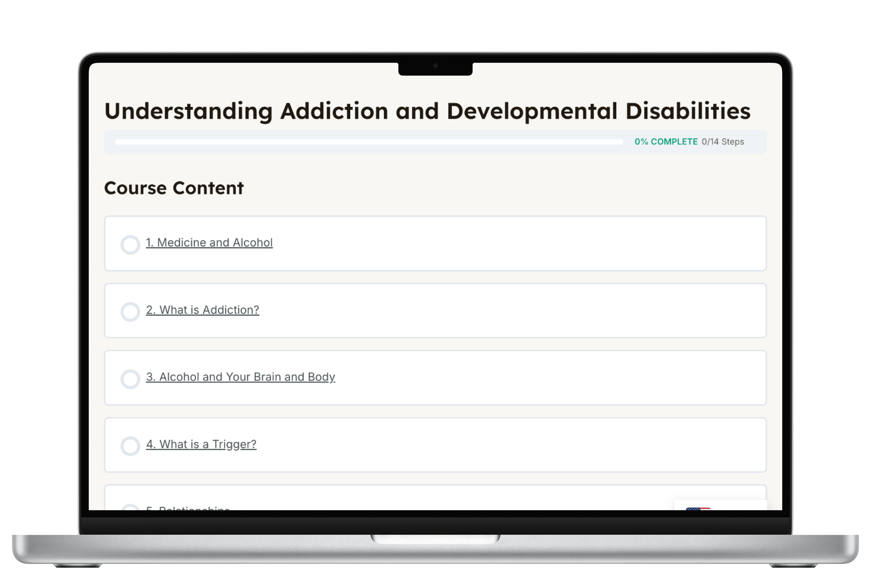
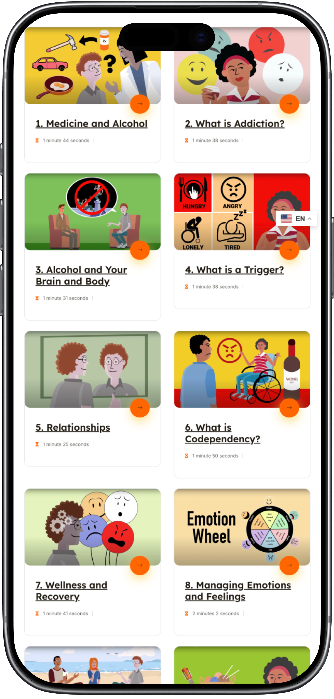
understanding.monarchnc.org
31

Slide 32



For health system leaders, behavioral health executives, and policymakers listening today—what are the most important steps they should consider if they want to move toward more integrated care fr co-occurring disorders?
Explore Upcoming Webinars & Resources At RECADEMY.org
32

